Slide 1
Indices
Tomasz Bartoszewski

Slide 2
Inverted Index
Search
Construction
Compression

Slide 3
Inverted Index
In its simplest form, the inverted index of a document collection is basically a data structure that attaches each distinctive term with a list of all documents that contains the term.

Slide 5
Search Using an Inverted Index

Slide 6
Step 1 – vocabulary search
finds each query term in the vocabulary
If (Single term in query){
goto step3;
}
Else{
goto step2;
}

Slide 7
Step 2 – results merging
merging of the lists is performed to find their intersection
use the shortest list as the base
partial match is possible

Slide 8
Step 3 – rank score computation
based on a relevance function (e.g. okapi, cosine)
score used in the final ranking

Slide 9
Example

Slide 10
Index Construction

Slide 11
Time complexity
O(T), where T is the number of all terms (including duplicates) in the document collection (after pre-processing)

Slide 12
Index Compression

Slide 13
Why?
avoid disk I/O
the size of an inverted index can be reduced dramatically
the original index can also be reconstructed
all the information is represented with positive integers -> integer compression

Slide 14
Use gaps
4, 10, 300, and 305 -> 4, 6, 290 and 5
Smaller numbers
Large for rare terms – not a big problem

Slide 15
All in one

Slide 16
Unary
For x:
X-1 bits of 0 and one of 1
e.g.
5 -> 00001
7 -> 0000001

Slide 17
Elias Gamma Coding
$1+\left\lfloor \log_{2}{x}\right\rfloor$ in unary (i.e., $\left\lfloor \log_{2}{x}\right\rfloor$ 0-bits followed by a 1-bit)
followed by the binary representation of x without its most significant bit.
efficient for small integers but is not suited to large integers
$1+\left\lfloor \log_{2}{x}\right\rfloor$ is simply the number of bits of x in binary
9 -> 000 1001

Slide 18
Elias Delta Coding
For small int longer than gamma codes (better for larger)
gamma code representation of $1+\left\lfloor \log_{2}{x}\right\rfloor$
followed by the binary representation of x less the most significant bit
Dla 9:
$1+\left\lfloor \log_{2}{9}\right\rfloor =4$ -> 00100
9 -> 00100 001

Slide 19
Golomb Coding
values relative to a constant b
several variations of the original Golomb
E.g.
$$q=\left\lfloor x/b\right\rfloor$$
Remainder $r=x−qb$ (b possible reminders e.g. b=3: 0,1,2)
binary representation of a remainder requires $\left\lfloor \log_{2}{b}\right\rfloor$ or $\left\lceil \log_{2}{b}\right\rceil$
write the first few remainders using $\left\lfloor \log_{2}{b}\right\rfloor$ r$est \left\lceil \log_{2}{b}\right\rceil$

Slide 20
Example
b=3 and x=9
$q=\left\lfloor 9/3\right\rfloor =3$
$i=\left\lfloor \log_{2}{3}\right\rfloor =1$ => $d=1$ ($d=2^{i+1}−b$)
$r=9−3∗3=0$
Result 00010

Slide 21
The coding tree for b=5

Slide 22
Selection of b
$b≈0.69∗\frac{N}{n_{t}}$
N – total number of documents
$n_{t}$– number of documents that contain term t

Slide 23
Variable-Byte Coding
seven bits in each byte are used to code an integer
last bit 0 – end, 1 – continue
E.g. 135 -> 00000011 00001110

Slide 24
Summary
Golomb coding better than Elias
Gamma coding does not work well
Variable-byte integers are often faster than Variable-bit (higher storage costs)
compression technique can allow retrieval to be up to twice as fast than without compression
space requirement averages 20% – 25% of the cost of storing uncompressed integers

Slide 25
Latent Semantic Indexing

Slide 26
Reason
many concepts or objects can be described in multiple ways
find using synonyms of the words in the user query
deal with this problem through the identification of statistical associations of terms

Slide 27
Singular value decomposition (SVD)
estimate latent structure, and to remove the “noise”
hidden “concept” space, which associates syntactically different but semantically similar terms and documents

Slide 28
LSI
LSI starts with an m*n termdocument matrix A
row = term; column = document
value e.g. term frequency

Slide 29
Singular Value Decomposition
factor matrix A into three matrices:
$$A=UEV^{T}$$
m is the number of row in A
n is the number of columns in A
r is the rank of A, $r≤min⁡(m,n)$

Slide 30
Singular Value Decomposition
U is a $m∗r$ matrix and its columns, called left singular vectors, are eigenvectors associated with the r non-zero eigenvalues of $AA^{T}$
V is an $n∗r$ matrix and its columns, called right singular vectors, are eigenvectors associated with the r non-zero eigenvalues of $A^{T}A$
E is a $r∗r$ diagonal matrix, E = diag($σ_{1}$, $σ_{2}$, …, $σ_{r}$), $σ_{1}>0$. $σ_{1}$, $σ_{2}$, …, $σ_{r}$, called singular values, are the non-negative square roots of r non-zero eigenvalues of $AA^{T}$ they are arranged in decreasing order, i.e., $σ_{1}≥σ_{2}≥…≥σ_{r}>0$
reduce the size of the matrices

Slide 31
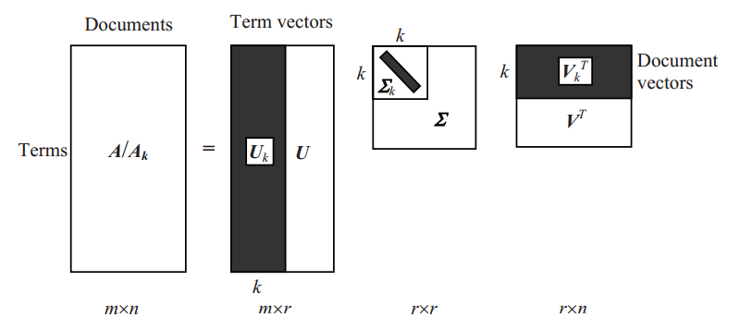
$$A_{k}=U_{k}E_{k}V_{k}^{T}$$

Slide 32
Query and Retrieval
q - user query (treated as a new document)
document in the k-concept space, denoted by $q_{k}$
$q_{k}=q^{T}U_{k}E_{k}^{−1}$

Slide 33
Example

Slide 34
Example

Slide 35
Example

Slide 36
Example

Slide 37
Example

Slide 38
Example

Slide 39
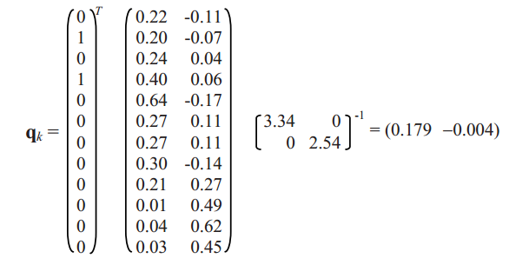
Example
q - “user interface”

Slide 40
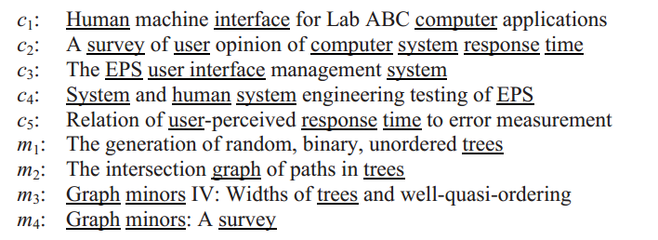
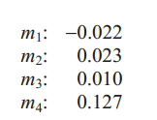
Example

Slide 41
Summary
The original paper of LSI suggests 50–350 dimensions.
k needs to be determined based on the specific document collection
association rules may be able to approximate the results of LSI

